Slide 1
Washington DC Bikeshare Time Series
Nicholas Sager & Anishka Peter

Slide 2
Table of contents
01
02
03
04
05
Bikeshare Data
Univariate Analysis
Multivariate Analysis
Neural Networks
Comparison

Slide 3
DC Bikeshare Data
Bikeshare Data from 2011-2012 in Washington DC
Originally Hourly data and we combined it into daily
Data containing:
Information about the day
Weather
Counts of users
We are interested in forecasting the Total Users on a given day.

Slide 4
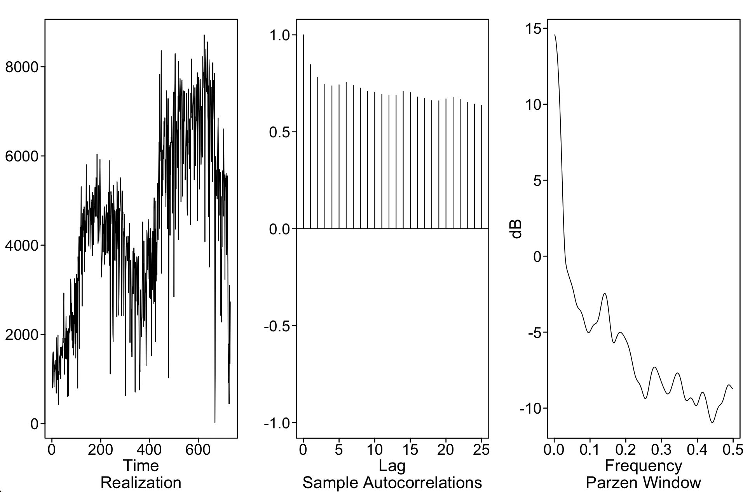
The Data
Two years of bikeshare data containing:
Information about the day
Weather
Counts of users
We are interested in forecasting the Total Users on a given day.

Slide 5
The Data
Total users has slowly dampening autocorrelation
Evidence of a weekly cycle (f = 0.14)
Dickey-Fuller test and overfit tables inconclusive on whether models should include a nonstationary factor
We will model it both ways

Slide 6
02
Univariate Analysis
Notes:
First we performed univariate analysis on our data

Slide 7
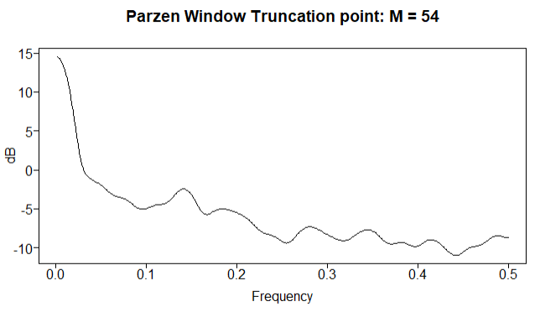
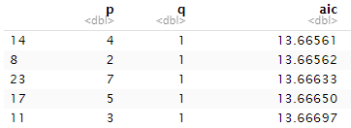
ARMA Model
Large peak at f = 0 which may indicate wandering behavior
Using AIC to fit an ARMA model we got an ARMA(4,1) model
Final model in the form:
Notes:
we fit a stationary model because we see a dominating peak at f = 0 in the spectral density plot which could indicate wandering behavior. We ended up with an ARMA(4,1) using AIC and after checking the residuals, it seemed like this model sufficiently whitened the residuals .
The final form of the model is here.

Slide 8
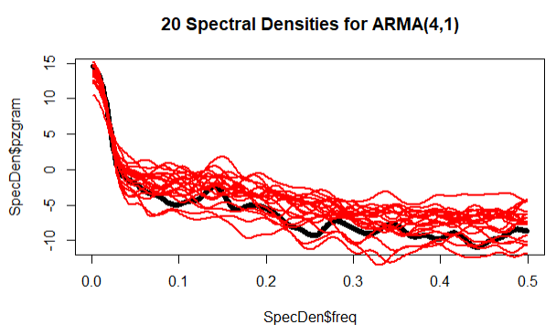
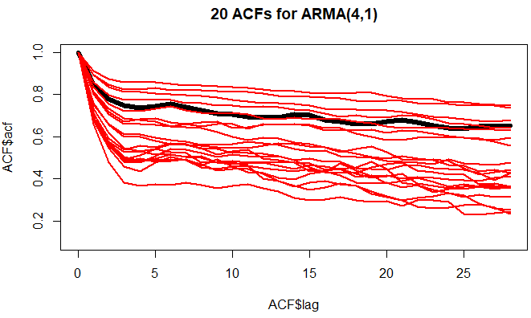
ARMA Model
Spectral Density
All have dominating peaks at f = 0
All are the lowest at f = 0.5
Missing some of the minor peaks like at about f = 0.14
ACF
No consistency in the ACF’s so there could be improvements
Notes:
We used the model to generate and plot the spectral densities of 20 realizations. The spectral densities of the realization capture the main peak but are missing some of the minor peak which indicates room for improvement in the model.
Looking at the 20 acfs they are slowly dampening but the variation in the acfs at each lag is very large so the model can be improved to decrease the ACF’s variability

Slide 9
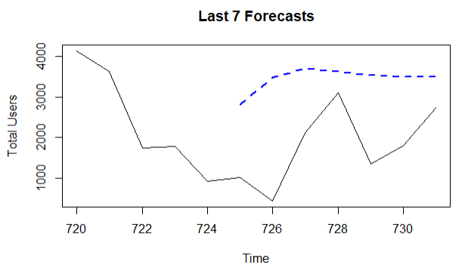
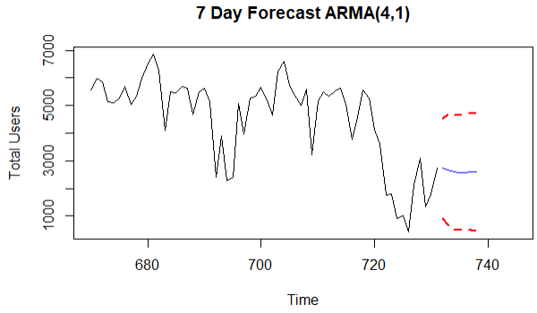
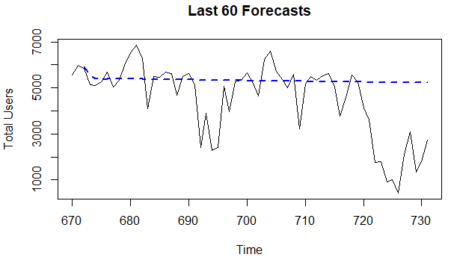
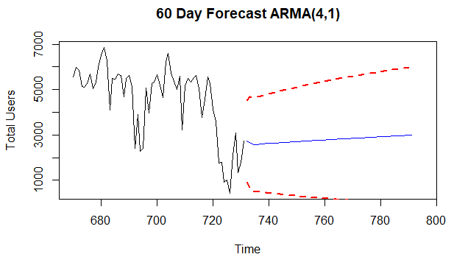
ARMA Model
Forecasts
Both approach the mean which is more apparent in the longer forecast
ASE
7 day: 3358954
60 day: 3058217
rwRMSE
7 day: 991.812
60 day: 1224.59
Notes:
Looking at the last 7 day and last 60 day forecasts we see them trending towards the mean very quickly which may not be very useful when predicting the number of bike users long term. Here are the ASE’s these forecasts which are very similar to each other. On the far right we can also see the 7 and 60 day ahead forecasts with their confidence intervals.
Now I will pass it to nick to talk about our ARIMA Model

Slide 10
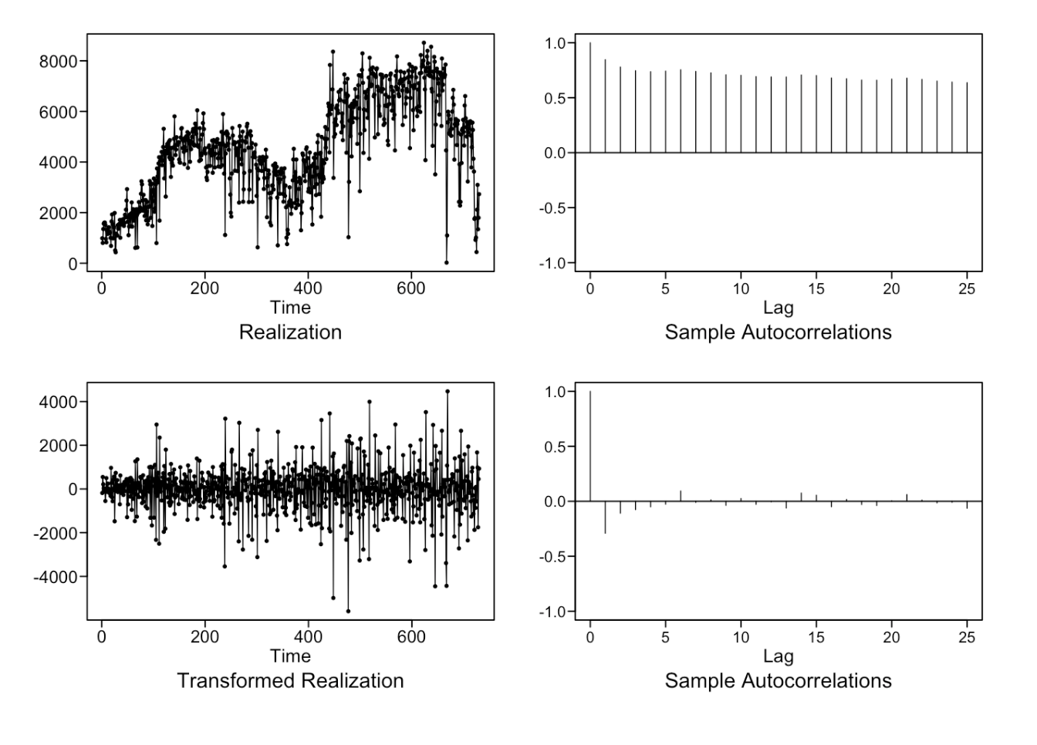
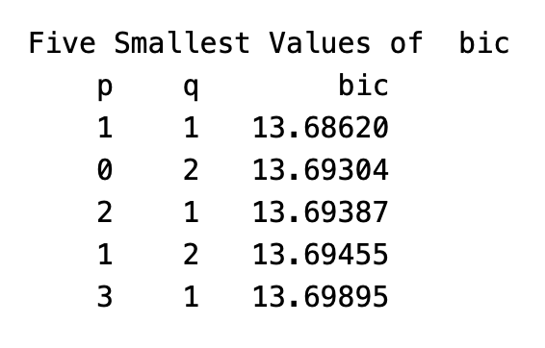
ARIMA Model
Due to the slowly dampening autocorrelations, we took the first difference of the data
Appears more stationary
Fitting the residuals with and ARMA model:
AIC and BIC pick ARMA(1,1)

Slide 11
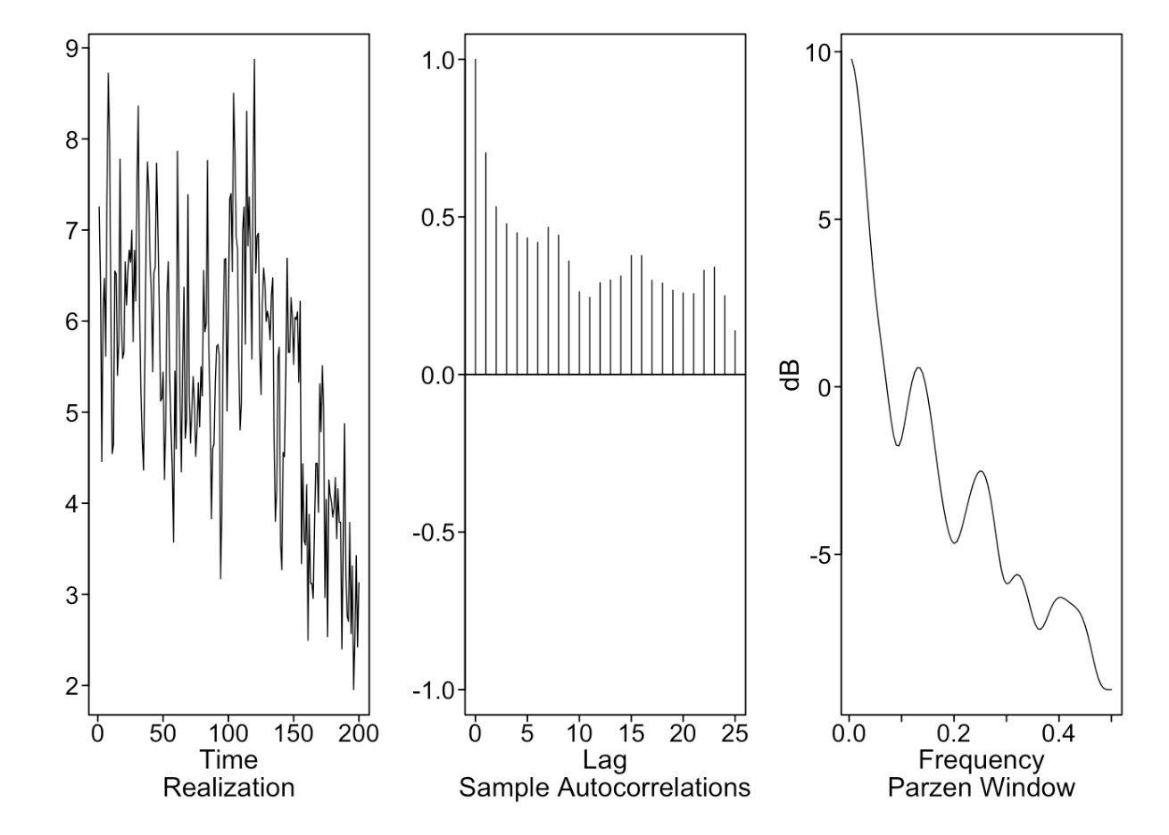
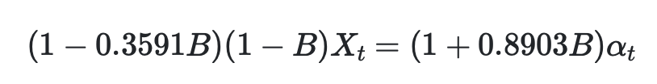
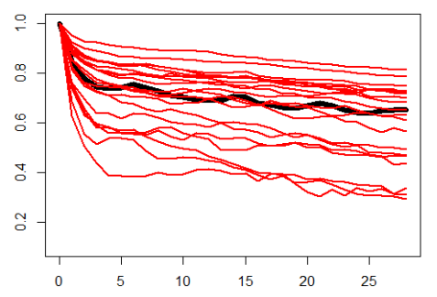
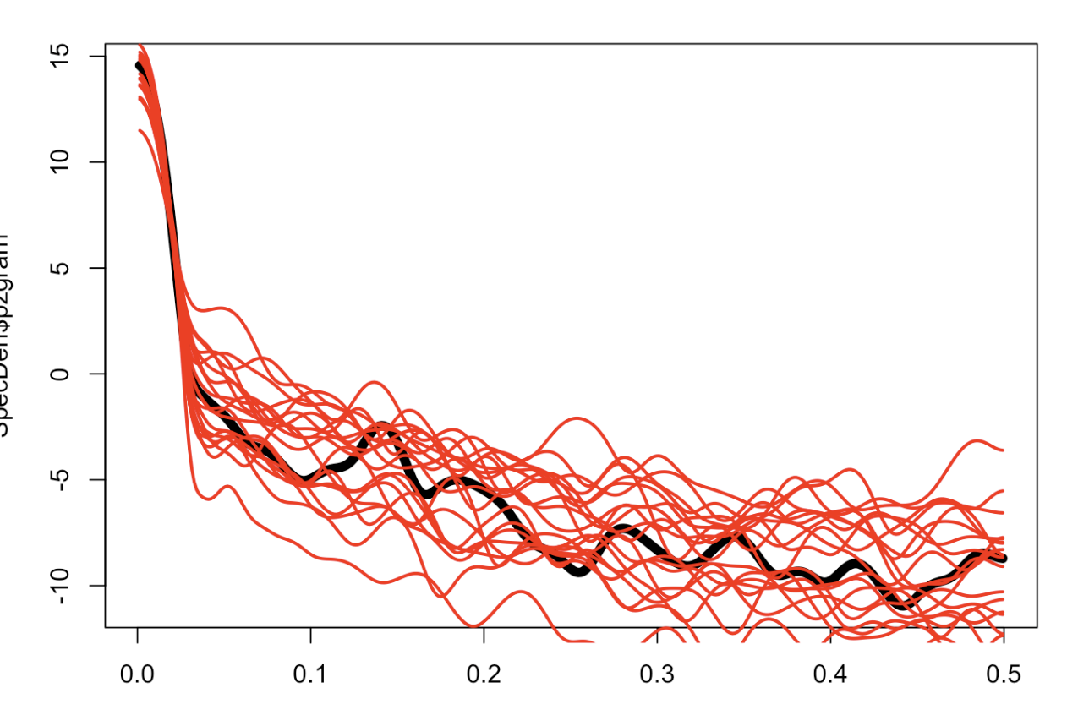
ARIMA Model
The final model is of the form:
Generated realizations capture some aspects of the original
Autocorrelation is weaker
Weekly behavior less evident.
Generated Spectral Densities and ACFs could be improved upon.
ACFs
SDs

Slide 12
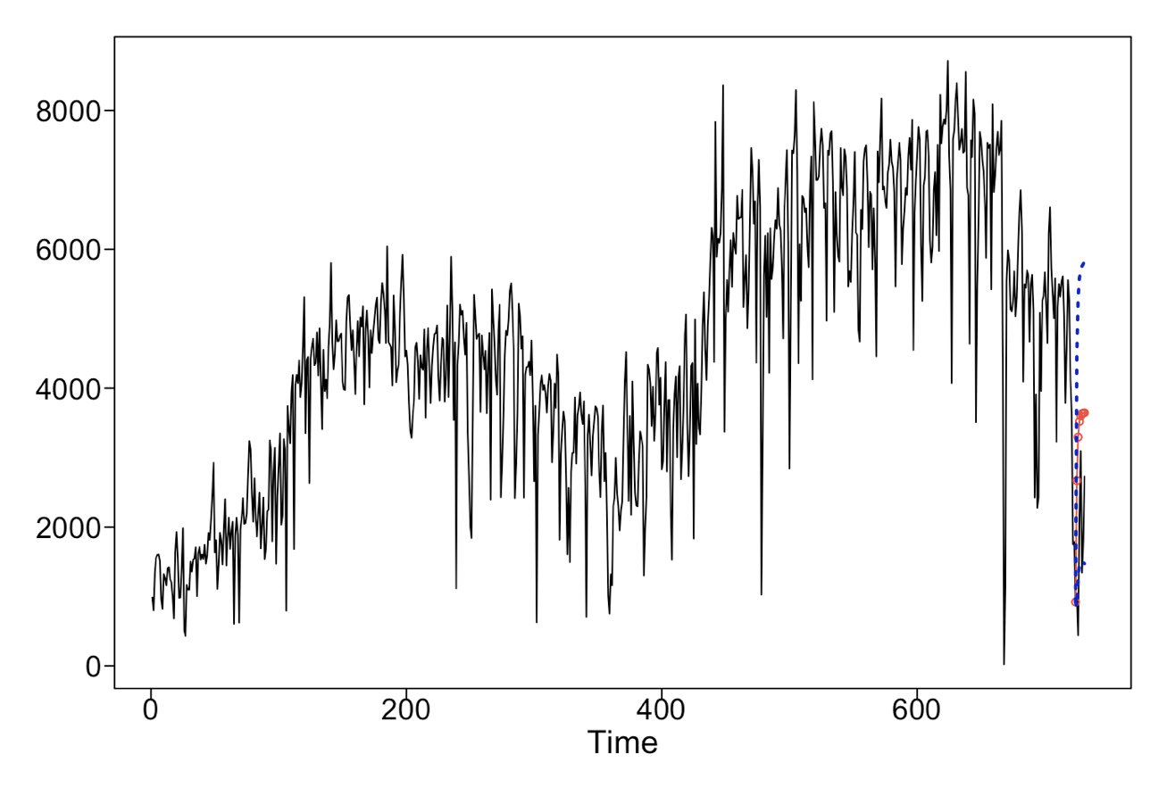
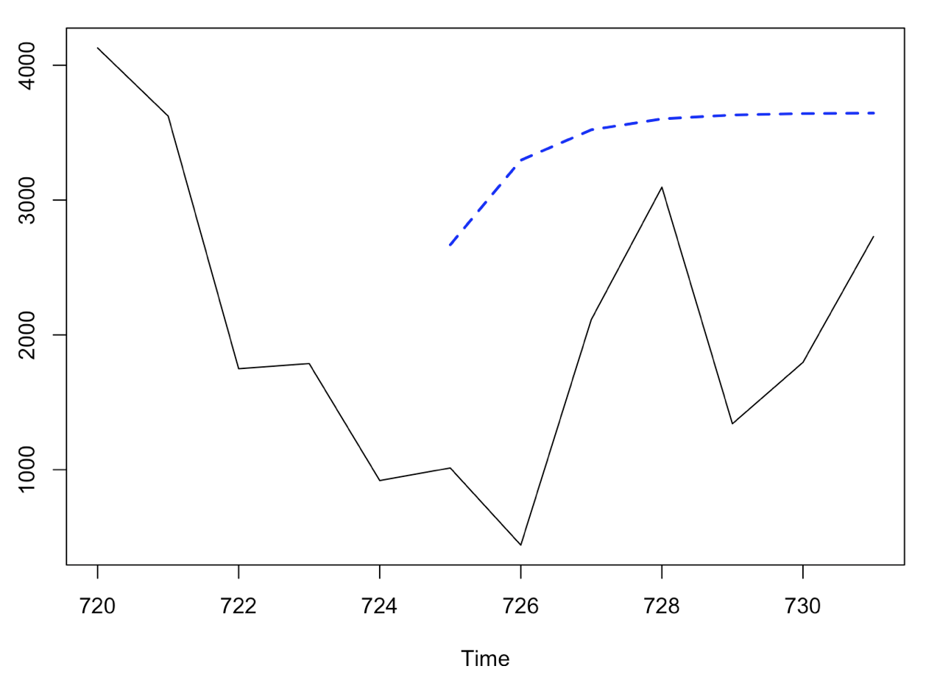
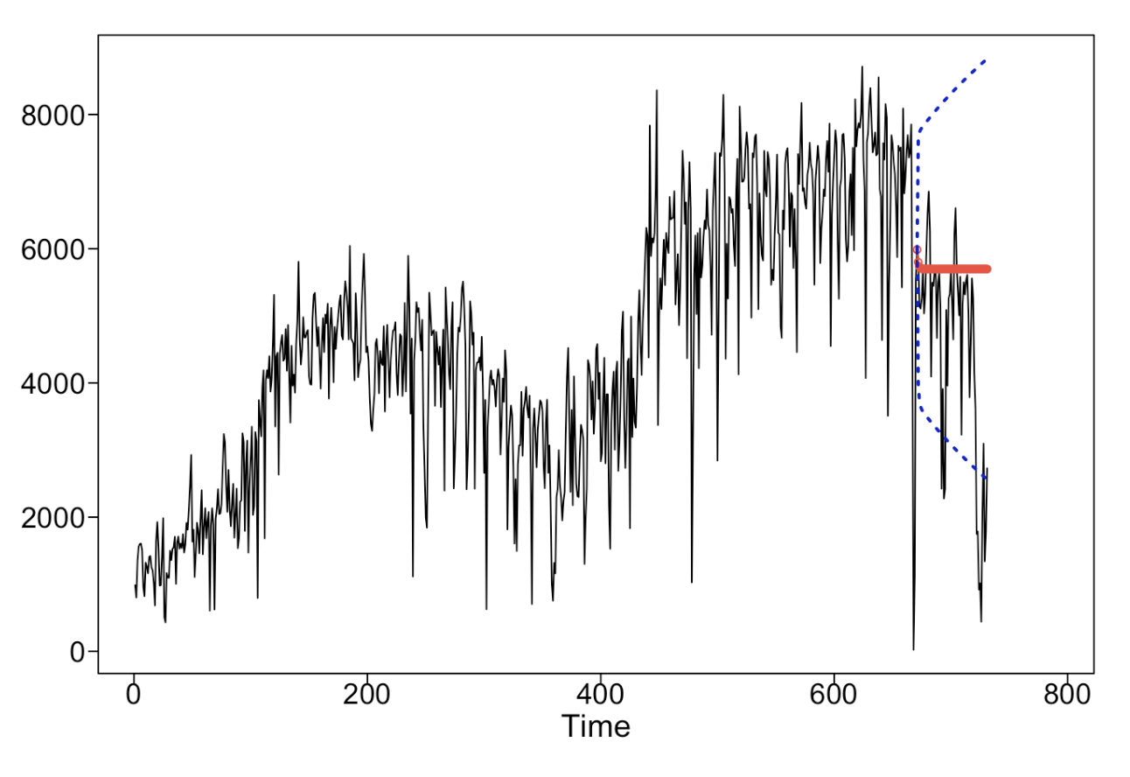
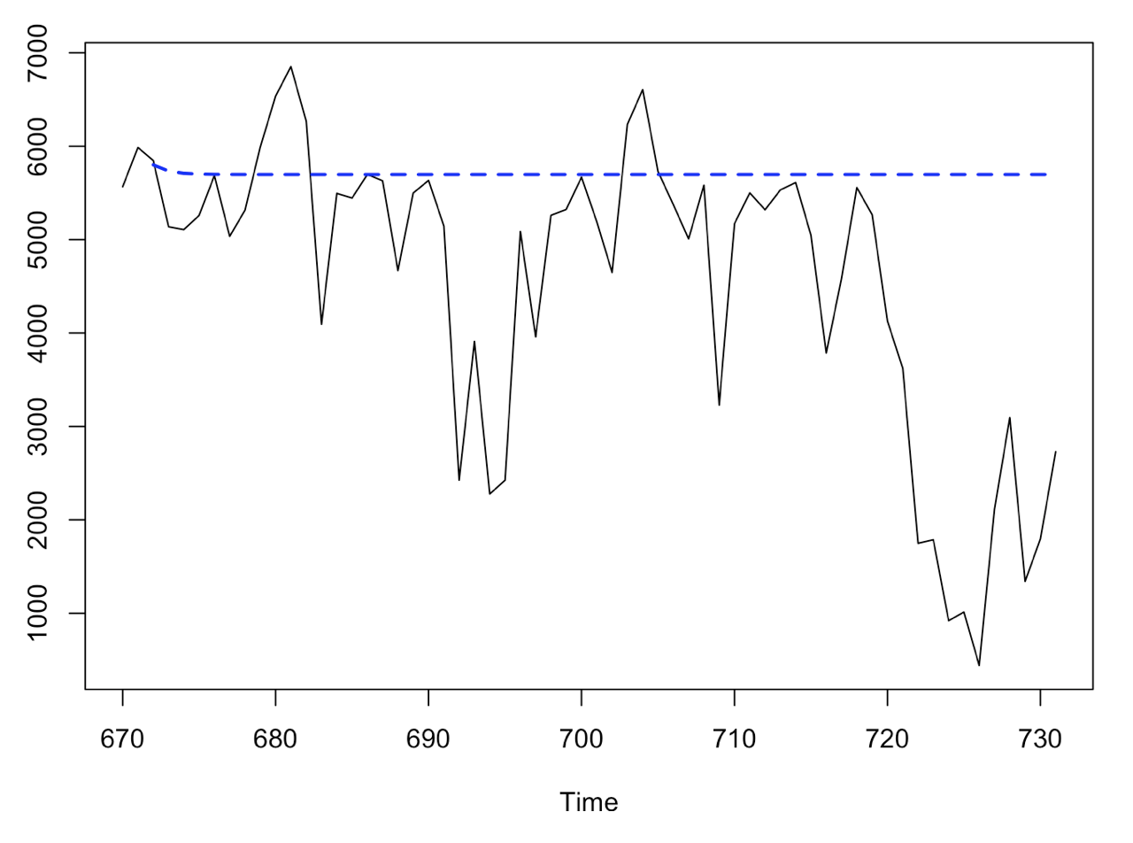
ARIMA Model
Forecasts:
Both short and long-term quickly approach the mean
May still be Useful
ASE:
7-day: 3,230,238
60-day: 3,930,824
rwRMSE:
7-day: 1,237
60-day: 1,503

Slide 13
03
Multivariate Analysis
Notes:
Now we will move onto our Multivariate Analysis so that we can consider any correlation between the total number of users and the various other variables in the dataset.

Slide 14
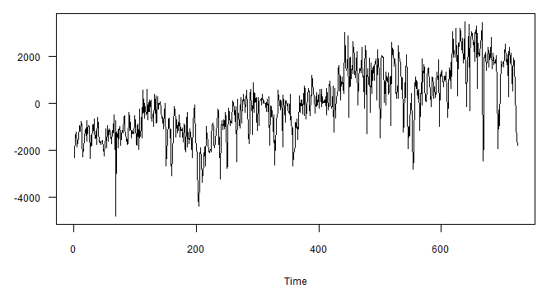
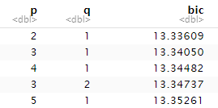
MLR with Correlated Errors
Variables Considered
Season
Holiday
Day of the Week
Working Day
Temperature
Temperature Feels
Humidity
Wind Speed
Humidity, Temperature, Wind Speed, and Day of the Week considered Significant
Correlated Errors fitted with ARMA(2,1) model
Notes:
We created a multiple linear regression with correlated errors model using the following 8 variables because these all had to do with the time of year or the weather conditions of the day which we assumed would affect how many people wanted to rent a bike to get around DC. Then we narrowed it down to Humidity, temperature, wind speed and day of the week after looking at the coefficient estimates and their standard deviations to determine significance
Then we modeled our errors with an ARMA(2,1).

Slide 15
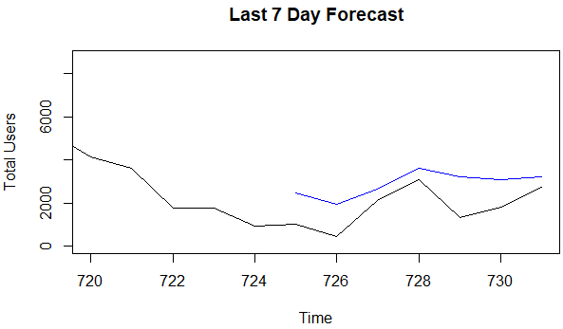
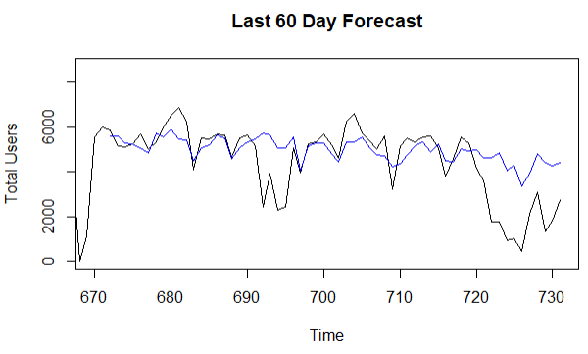
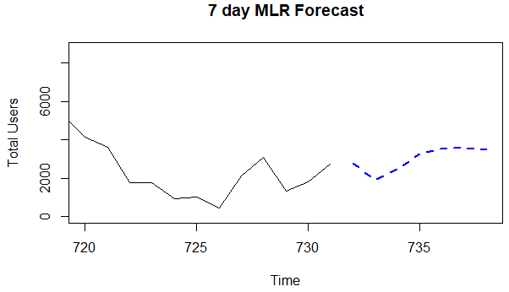
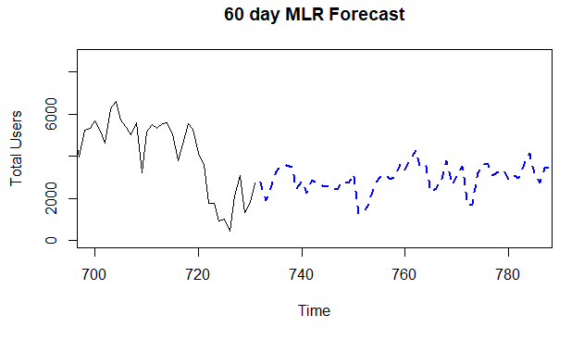
MLR with Correlated Errors
Last n Forecasts
Very close to the original data
ASE
7-day: 1481882
60-day: 1912404
N Ahead Forecasts
Look like they capture the general pattern of the data
Notes:
For the Last 7 and last 60 days, the predictions are close to the true values but for the longer horizon they have less variability day to day compared to the actual data. Here our ASE’s are much smaller than our other models. And at the bottom we have the forecasts for 7 and 60 days ahead which look like they capture the general trend in the data.
Now i will pass it back to nick to talk about our next model

Slide 16
04
Neural Network

Slide 17
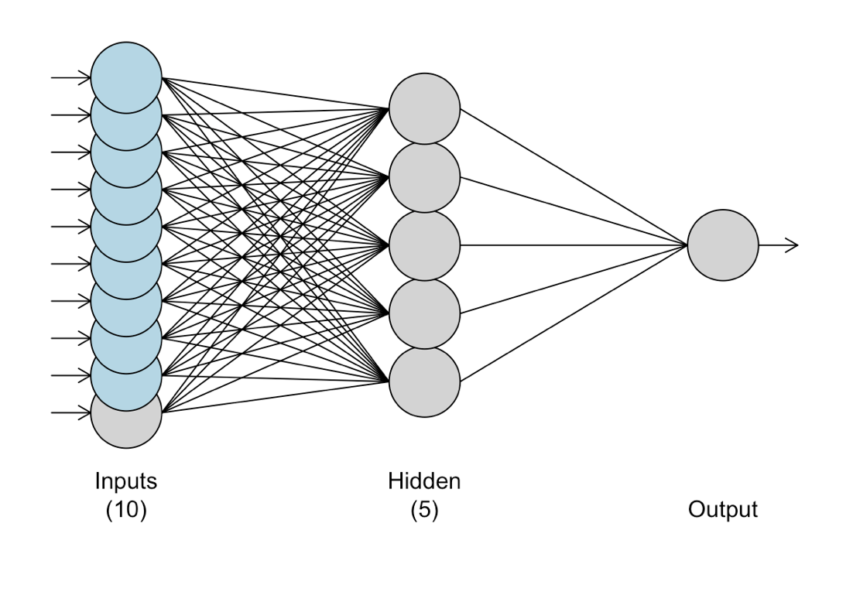
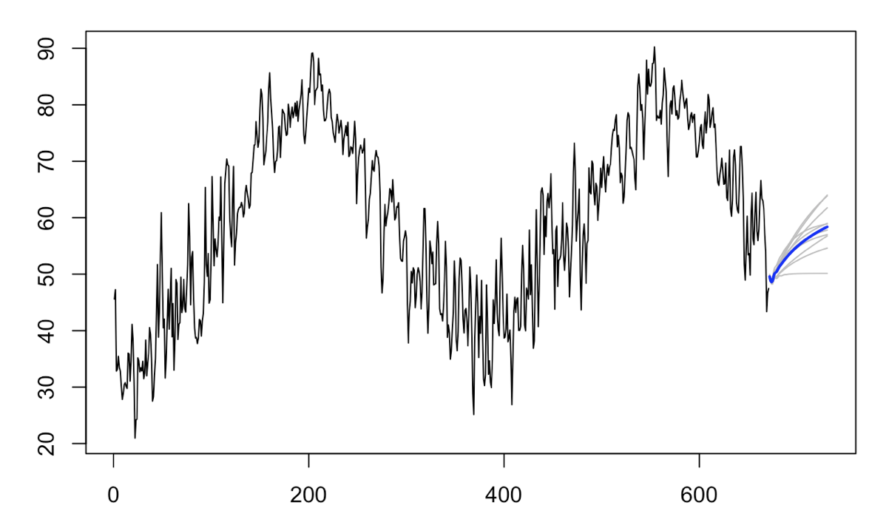
MLP Model
First, short- and long-term forecasts are generated for relevant predictor variables.
MLP does well, although a production model might do this programmatically for some
For example, Temperature:
A MLP is fit with this architecture:

Slide 18
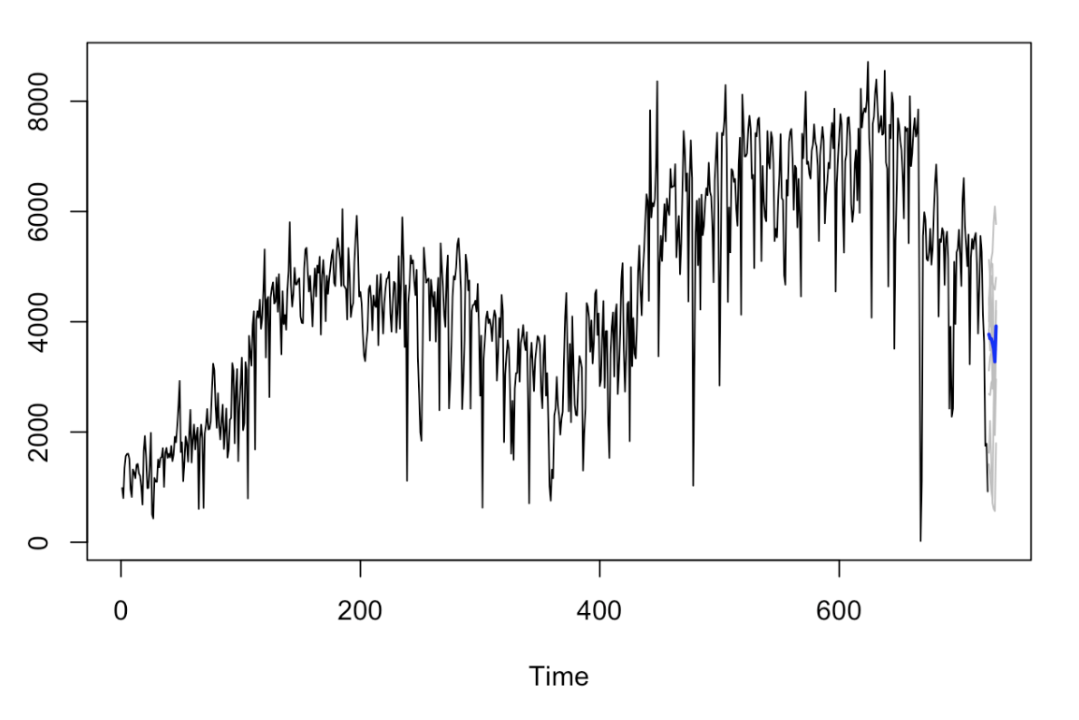
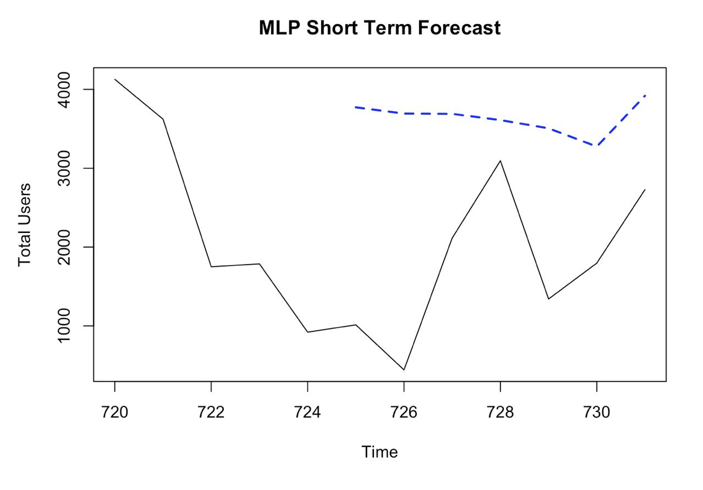
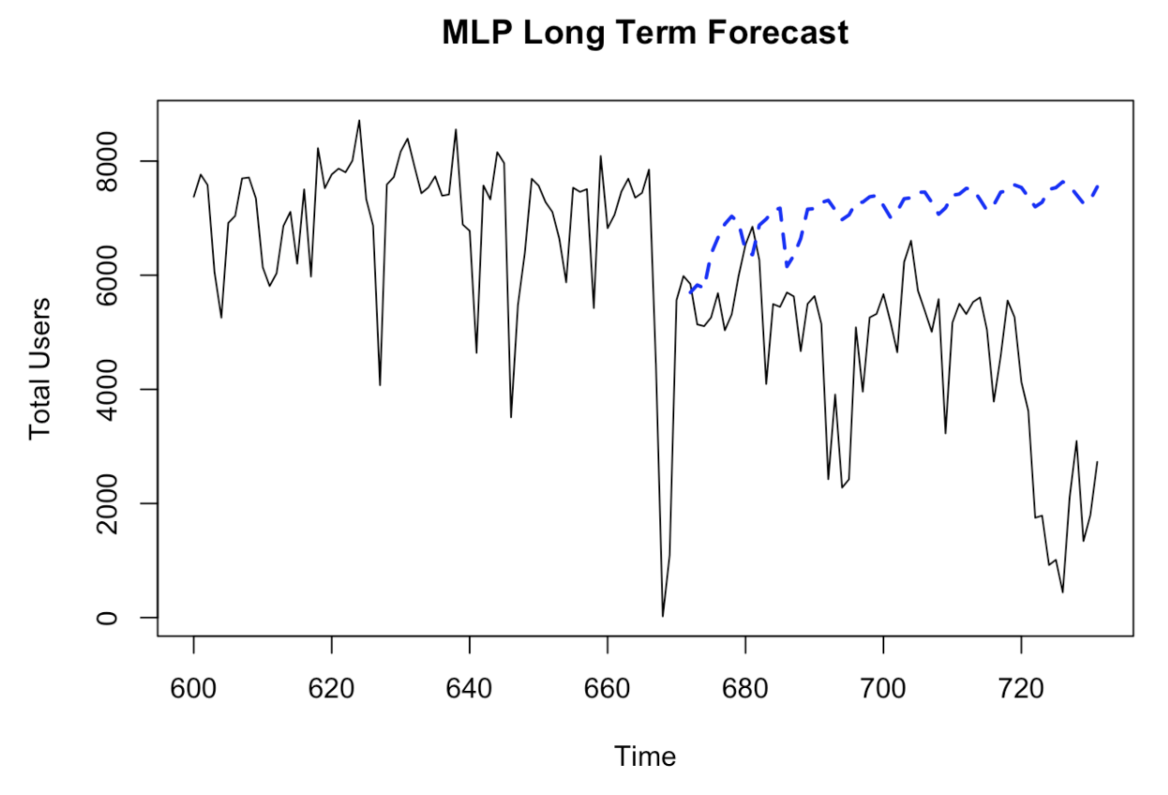
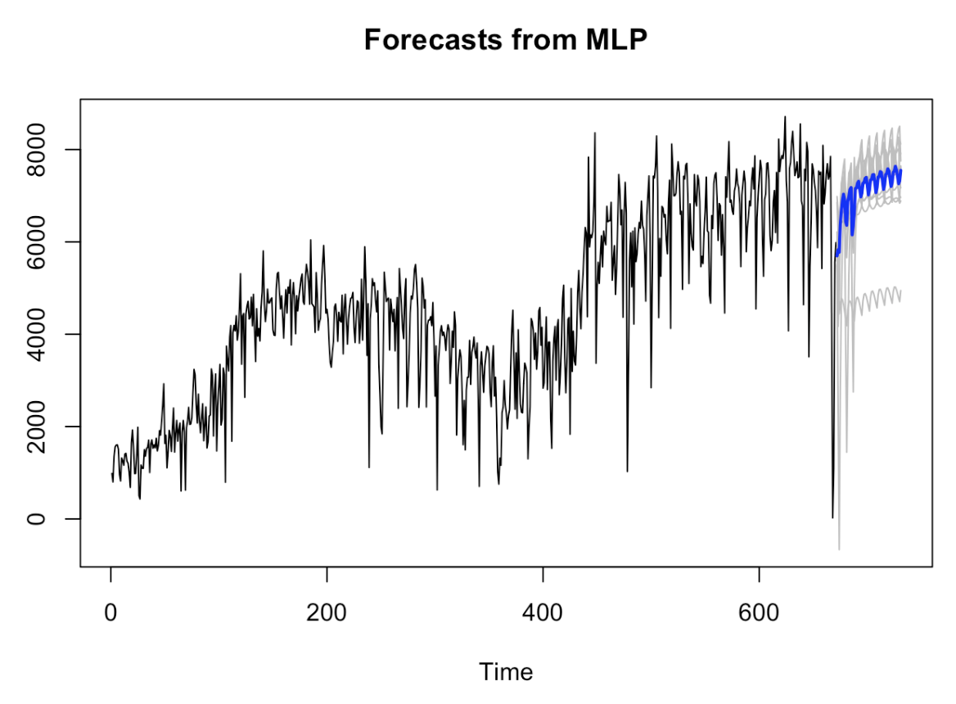
MLP Model
Forecasts:
Both appear to capture the weekly cycle
Long has significant error from missing the large decrease
ASE:
7-day: 4,177,345
60-day: 10,000,456
rwRMSE:
N/A

Slide 19
05
Comparison
Notes:
In our comparisons section we created an ensemble model and compared all our models to determine our preferred model for this data se

Slide 20
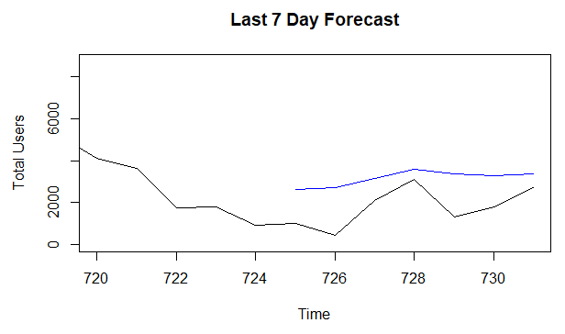
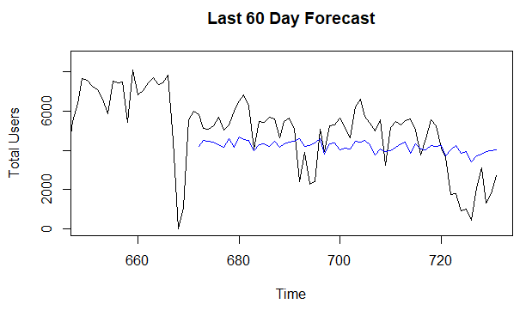
Ensemble model
Average of ARMA(4,1) and MLR with Correlated Errors
ASE
7-day: 2281763
60-Day: 2189693
Notes:
We averaged the ARMA(4,1) and our MLR forecasts because they had the best ASE’s and predictions
The last 7 and last 60 day forecasts look similar to MLRs where they capture the trend in the data but some of the larger dips in the original data are not seen in the forecasts

Slide 21
Model Comparisons
Model | 7-day ASE | 60-day ASE | 7-day rwRMSE | 60-day rwRMSE
ARMA | 3,358,954 | 3,058,217 | 991.812 | 1,224.59
ARIMA | 3,230,238 | 3,930,824 | 1,237 | 1,503
MLR with Corr Err | 1,481,882 | 1,912,404 | NA | NA
MLP | 4,177,345 | 10,000,456 | NA | NA
MLR with Corr Err + ARMA | 2,281,763 | 2,189,693 | NA | NA
MLR with correlated Errors has the best ASE, and the model can capture the correlation between the response variable and the multiple exogenous variables the best
Notes:
We see that MLR with correlated errors had the smallest ASE. This is probably because, the total number of bike users a day has some correlation with exogenous variables such as weather conditions and time of the year which we were able to model using the MLR with correlated errors model

Slide 22
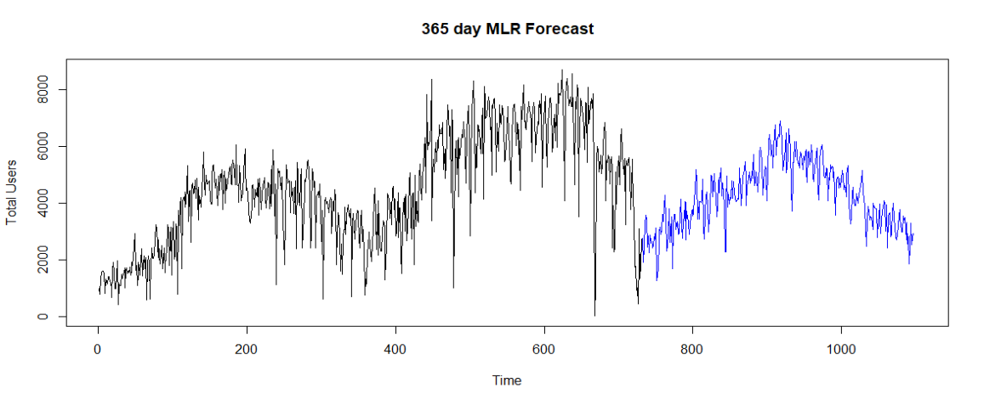
Final 365 Day Forecast
Notes:
So we used that model to forecast 1 year out from our end date which we have plotted here. This can give stakeholders in the bikeshare business in DC an insight into potential profits and can be used to further expand their business.

Slide 23
Thank You
Nicholas Sager: nsager@mail.smu.edu Anishka Peter: apeter@mail.smu.edu
Notes:
Thank You and feel free to reach out with any further questions our emails are down below.

